Slide 1
E205F Preparing for IELTS Unit 5 (Task 1)
Hazal WONG
hatwong@ouhk.edu.hk

Slide 2
Task 1: Describing graphical information (p.2)
In Task 1, you will look at a graph, chart or table and summarize the information selecting and reporting the main features, and making comparisons where relevant.
You are allocated 20 minutes for this task and told to write at least 150 words.
Maximum: ~180 words!

Slide 3
Analysing information presented graphically (p.2)
What sort of information it contains > what the graph is about
What is its purpose?
We need to talk about overall trends and illustrate these trends by giving some specific data.
1st paragraph:
Introduction + overall trend of the graph (no more than 3 key features)

Slide 4
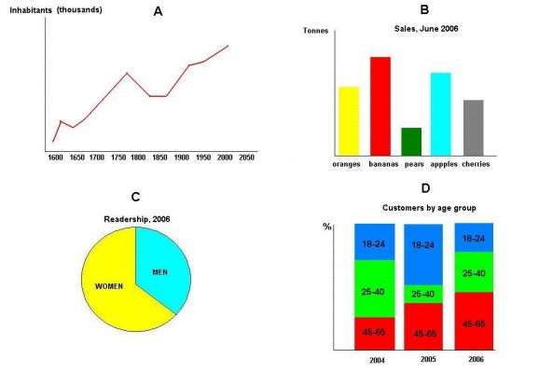
Some key points to note first
In interpreting graphical information, we should start by:
• reading any headings;
• checking what the vertical and horizontal axes, columns or rows represent;
• looking at the key; and
• noting the units or time periods.

Slide 5

1 What is it about, in general?
(That is, try to complete the sentence ‘This graph/table/chart represents/shows/illustrates …’.)
2 What main trend(s) does it show?
3 Are there any exceptions to this trend (these trends)?
4 Are any comparisons made?
5 What time period(s) does it cover? Tense

Slide 6
Activity 5.1 (p.3)
Think about how to interpret the bar chart below by answering the five questions above in writing.
Write in complete formal sentences.
Use the present tense in an introductory overview when describing the graph itself, then revert to the past or past perfect when discussing past events and trends.
Time limit: 20 minutes

Slide 7
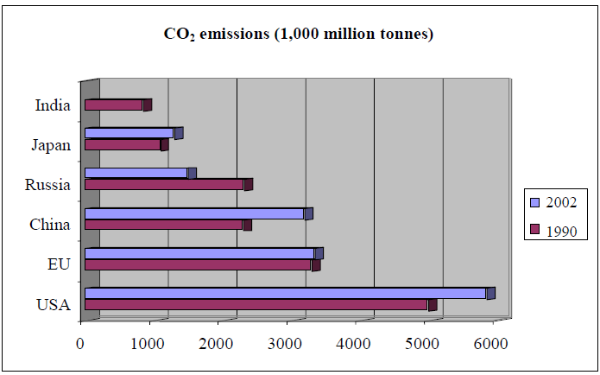

Slide 8
Activity 5.1 (Suggested Key)
This chart illustrates changes in the carbon dioxide emissions of the world’s major industrialized nations between 1990 and 2002.
There had been a general increase in emissions among the nations represented, although there was one major exception to this trend and comparative data were not available for India.
The exceptional case was Russia which showed a dramatic 25% decline in emissions. For other nations, the trend is in the opposite direction with China and the United States increasing emissions by around 30% and 20% respectively. The world’s largest producer of CO2 emissions throughout the period was the United States. The United States also had the second largest increase in emissions in the period.
 Introduction line
 Overview
 Main Content

Slide 9
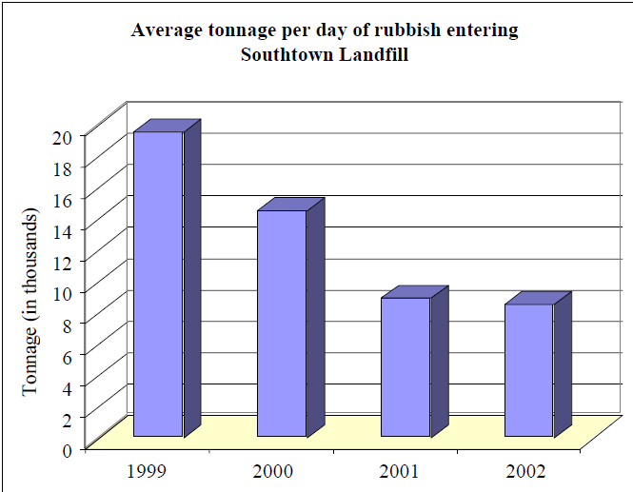
Another example (p.3)
Let’s look at another example.
The graph is not complex, but one can imagine careless readers misinterpreting it.

Slide 10
 Analysis:
A casual glance might suggest that, since each column is above a year, the columns represent the amount of landfill in that year – but, of course, the caption tells us that the columns represent daily tonnage.
This, then, is presumably an average figure. The vertical axis represents weight and the actual numbers represent thousands.
The graph shows that between 1999 and 2000 there was a drop in the daily tonnage of approximately 5,000 tonnes or around 25%, which is obviously a very significant drop.
One can imagine careless people talking of a 5% drop, thinking the figures are percentages, or saying there was a drop of 5 tonnes, forgetting the thousands.

Slide 11
Language hint (p.4)
Useful:
‘represent’, ‘drop’, ‘approximately’, ‘significant’, ‘further reduction’, ‘situation stabilized’, ‘appreciable’
Less likely:
‘column’ and ‘vertical axis’
(as they describe the graph rather than the information contained in it)

Slide 12
Establishing the topic and giving a clear overview (p.4)
An overview is a statement summarising the main trends shown in the figure.
It should give the reader information about the graph’s main topic, and refer to key places, dates or quantities.
It should not include specific details, and you should not copy long phrases or sentences from the question.

Slide 13
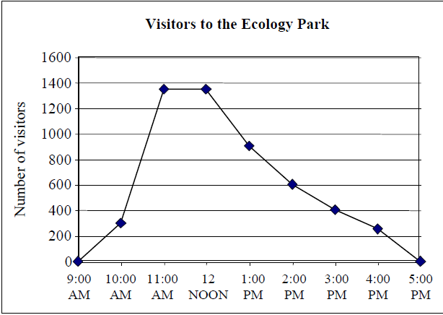
p.5
2-3 key trends
What tense?

Slide 14
p.5
The graph provides information on the times of arrival of visitors to the Ecology Park.
Overall, The number of visitors fluctuates throughout the day. It first increases, reaching a peak in the late morning, then gradually declines to the end of the day. From 9:00 a.m. people start entering the park. The numbers arriving rise very steeply between 10:00 a.m. and 11:00 a.m. From about 300 people at 10:00 a.m., they reach a peak at 11.00 a.m. with almost 1,400 people an hour entering the park.
This peak number of visitors continues until around noon when it starts dropping fairly steadily. At about 1:30 p.m., it is only half of what it was at its peak. After 2:00 p.m., the decline continues, though at a slightly gentler pace. So, for example, at just before 4:00 p.m. there are about 300 visitors an hour arriving. The decline continues until 5:00 p.m. when there are no further arrivals in the park.
In conclusion, the graph tells us that the number of visitors to the park peaks between 11:00 a.m. and 12:00 noon and drops off steadily in the afternoon until 5:00 p.m.

Slide 15
Activity 5.2 (p.6)
Write a short piece on this graph, and don’t forget to include an overview that tells the reader what it is about.
Be careful to interpret the data correctly, stating clearly what the graph shows, using an impersonal style with appropriate vocabulary, and noting the general trend and then supplying some data.
Time limit: 20 minutes

Slide 16
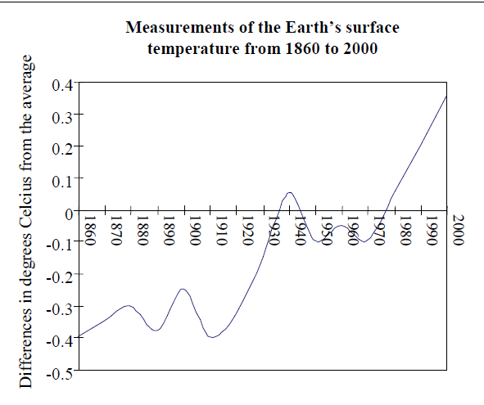

Slide 17
Activity 5.2 (Suggested key)
The graph shows variations in the surface temperature of the Earth from 1860 to 2000, shown as deviations from the average.
Considering the data in detail, there were fluctuations with many small increases and decreases in temperature over the course of the period.
However, if a larger view is taken, and the curve smoothed out a little, definite trends can be seen. Throughout the early decades of the 20th century, there was a steady rise in temperatures, reaching a peak around 1940. After a modest cooling thereafter until around 1970, temperatures rose sharply in the closing 20 years of the century, showing no signs of falling back as it ended. Between 1860 and 2000, a rise of on average 0.75 of a degree centigrade had been observed.

Slide 18
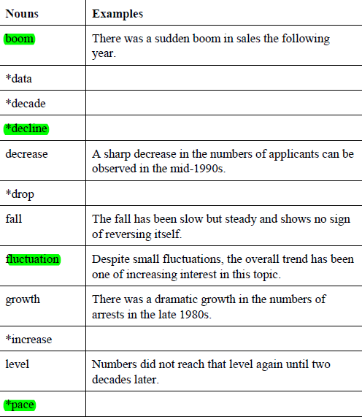
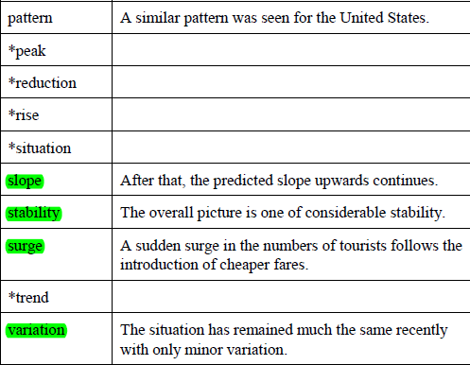
Useful words relating to graphs (p.6-10)

Slide 19
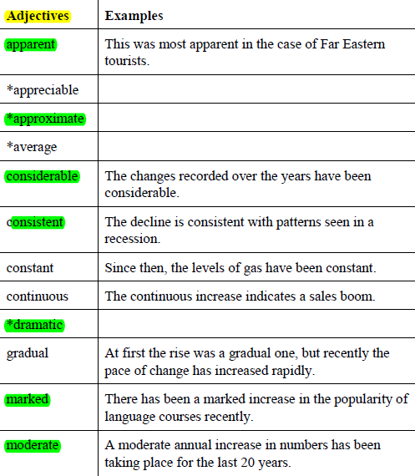
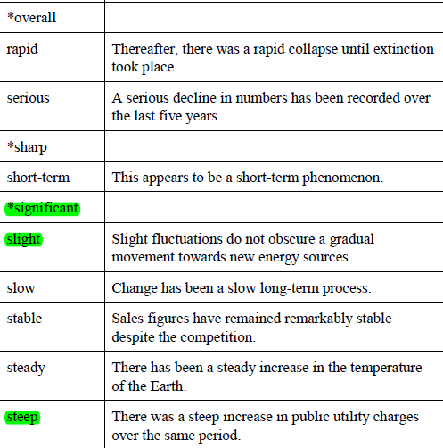

Slide 20
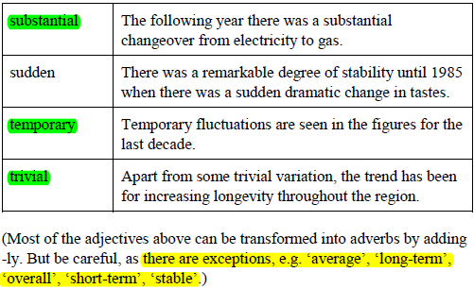

Slide 21
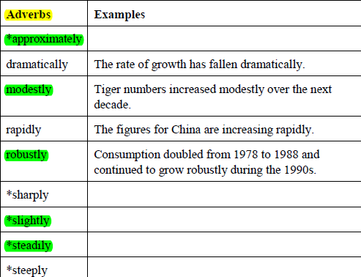
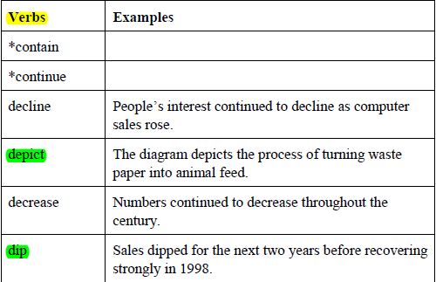

Slide 22
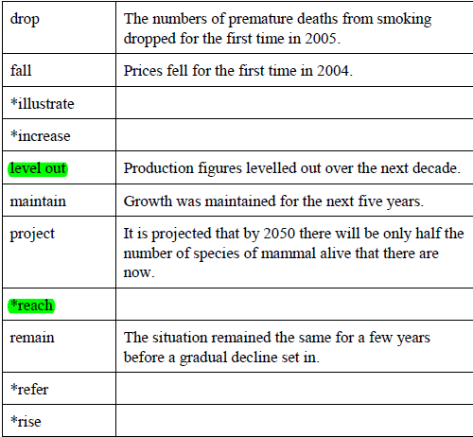
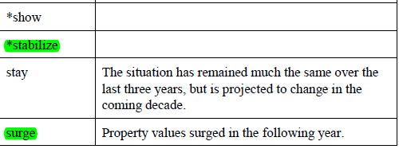

Slide 23
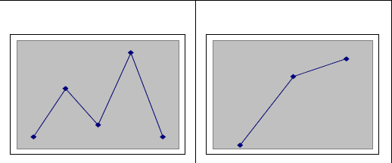
Activity 5.3 (p.11)
D considerable fluctuation
C sudden rise

Slide 24
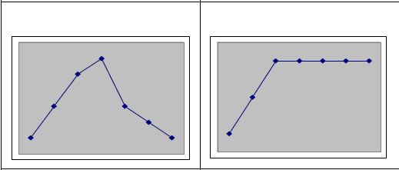
B reached a peak
E levelled out

Slide 25
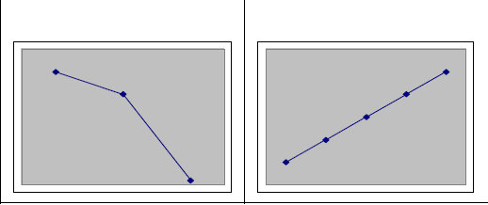
A sharp fall
F steady increase

Slide 26
Activity 5.4 (p.12)
peak
1 There was a gradual increase until numbers reached a p_________ in 1967.
2 The number of applicants continued to c_________ throughout the 1980s.
3 After years of stability, there was suddenly a period of f______________ and uncertainty.
climb
fluctuation

Slide 27
Activity 5.4
dramatic
4 In recent years, there has been a d____________ rise in the number of females entering the profession.
5 As we can o____________ from the figures, there are now more tourists coming from South East Asia than from any other region.
6 Levels of activity remained s__________ throughout 1998 and 1999.
7 The p__________ of development accelerated in the mid-20th century.
observe
stable
pace

Slide 28
Activity 5.4
trivial
8 Apart from some t_________ fluctuations, there have been no real changes in the situation over the last decade.
9 The data r___________ to the world’s oil reserves.
10 There was a sudden s__________ in inflation in the late 1970s.
refer
surge

Slide 29
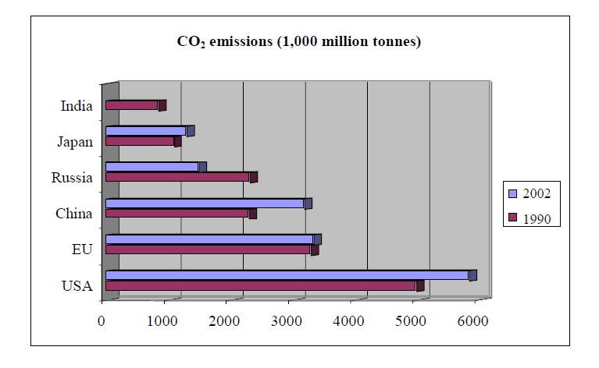
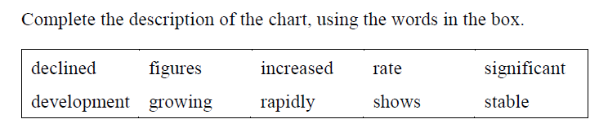
Activity 5.5 (p.15)

Slide 30
Activity 5.5 (p.15)
shows
The chart (1) ____________ carbon dioxide emissions of five major countries and the European Union, and their (2) ____________ over a recent 12-year period.
A number of (3) ____________ points can be made about the (4) ____________. Firstly, the United States was the largest emitter of carbon dioxide. It emitted more or less double the amount produced by the European Union (EU). Furthermore, the United States’ (5) ____________ of emission was (6) ____________ fast. In the 12-year period covered by the graph, it (7) ____________ its emissions by nearly 20%.
development
significant
figures
rate
growing
increased

Slide 31
Activity 5.5 (p.15)
During this same period, the Europeans managed to hold their emissions more or less steady. The figures for China were increasing (8) ____________ and China was fast drawing equal to the EU. Japan was producing about a fifth as much CO2 as the USA and was keeping the figure fairly (9) ____________ Russia’s emissions actually (10) ____________ sharply.
The information about India is limited and we cannot really draw any conclusions from it except that the country was another potential source of carbon dioxide in the atmosphere.
rapidly
stable
declined

Slide 32
Organization (p.16)
2-3 key trends/ patterns
Begin with an overview.
Write in coherent paragraphs (do not use bullet points).
Do not use an inappropriate form of text such as a letter or a speech.
Give paragraphs clear topic sentences.
Organize your paragraphs according to what is significant in the data (do not just recount the figures; look for interesting points).
Support your general points with information or data from the graph.

Slide 33
Avoiding explanation (p.16)
Your role in Task 1 is to give a neutral interpretation of the data and avoid commenting on it. (X I think/ I think/ It is believed that/ because…)
Adverbials such as sadly, luckily or disgracefully have no place here.
Nor do we need to explain the data. NO NEED
World knowledge also tells us that the collapse of the Soviet Union and the dislocation that followed it explains the fall in CO2 emissions rather than any strong ecological effort, but it is not necessary to mention this in describing the graph in Activity 5.5.

Slide 34
Activity 5.6 (p.17)
Look at the chart below.
Summarize the information by selecting and reporting the main features, and make comparisons where relevant.
Use at least 150 words.
Try to note places where different trends emerge and contrasts exist.
20 minutes + check together

Slide 35
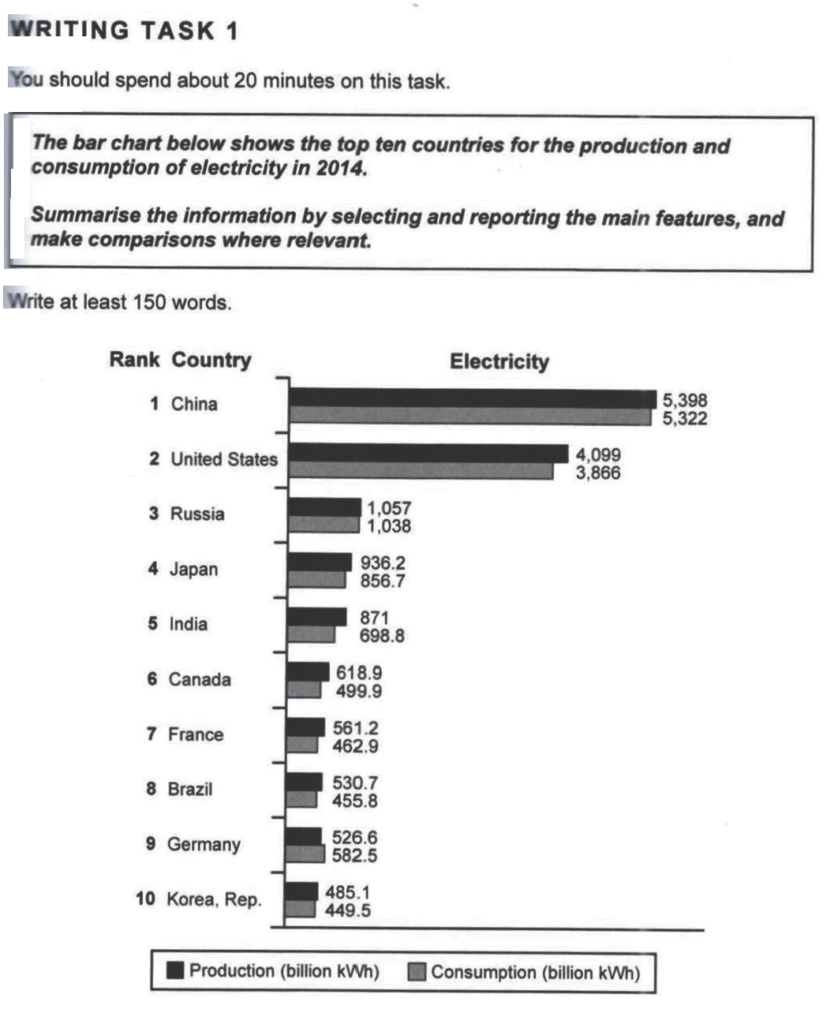

Slide 36
The bar graph compares electricity input and output in 10 countries in 2014. Overall, China and America were the greatest contributors and users, while other countries generated and used the source in various extents at a considerably lower level.
China possessed the highest numbers for both generation and usage at 5398 billion kWh and 5322 billion kWh respectively, followed closely by America, which/who produced 4099 billion kWh and utilized 3866 billion kWh of electricity.
One interesting observation is that Germany was the only nation where its input was lower than its yield, though the difference was not significant. For the remaining places, the production rate was more than their corresponding output, in which the nations shared a similar pattern ranging from 449.5 to 1038 billion kWh in manufacture and 485.1 to 1057 billion kWh in usage.
In summary, China and the U.S.A. manufactured and utilized electricity at a more substantial level than the rest of the countries, where almost all of them experienced a surplus for the period given.
(169 words)

Slide 37
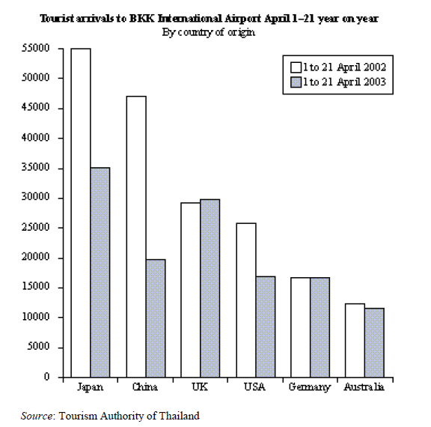

Slide 38
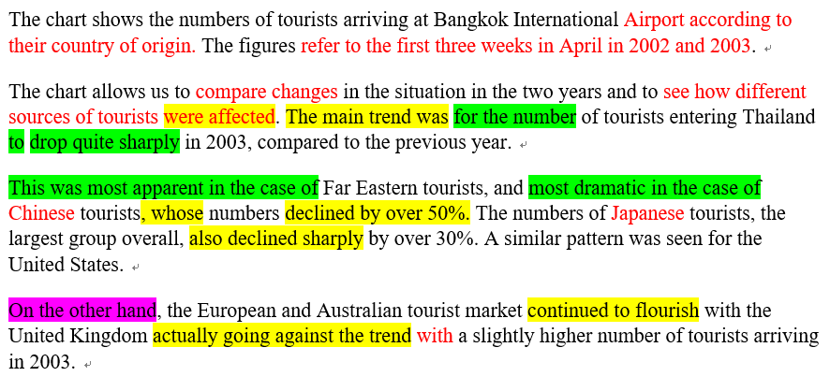
Activity 5.6 (p.17) (Suggested key)

Slide 39
For Self-revision:
Comparison of graphs: (p.17-20)
Some other types of graphical information
(p.21-23)

Slide 40
 Extra slides of Task 1 from Hazal

Slide 41
Structure of Task 1 Graph Description
Structure of Task 1 (150-180 words)
Introduction: (1) an opening sentence explaining what the graph is about and
(2) one or two sentences describing the ________________ trend (Overview)
2-3 keys
Body 1: first main fact and _______________________ details relating to overall trend
Relevant & descriptive
Body 2: second main fact and ______________________ details relating to overall trend
Relevant & descriptive
1-line summary: paraphrase/ echo your overview and a quick wrap-up

Slide 42
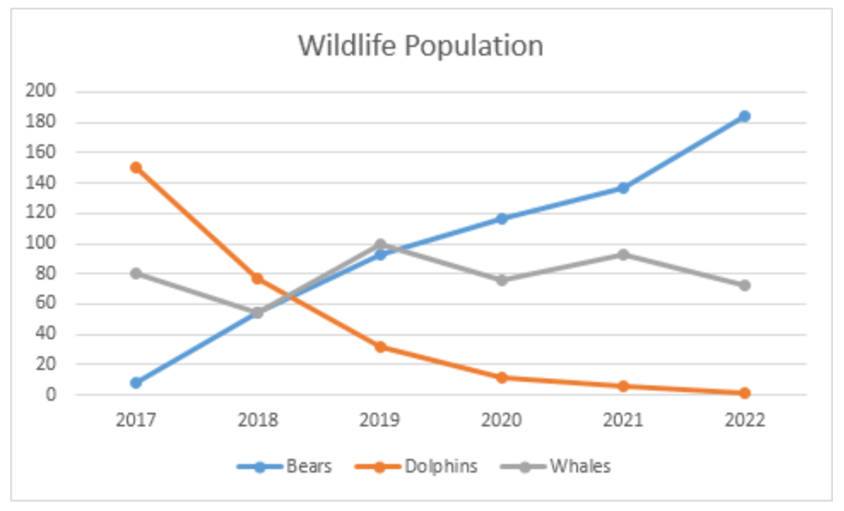
Describing Trends
Verbs and nouns
Place the verbs below in the correct boxes, according to the direction of the trend they describe.
⬆ Going up
⬇ Going down
~~ The same
Rose to/ increased to/
went up to/ climbed to
decreased (to) | increased (to) | remained steady (at)
fell (to) | dipped (to) | climbed (to)
stayed constant (at) | went up (to) | remained stable (at)
rose (to) | dropped (to) | maintained the same level
declined (to) | did not change | reduced (to)
went down (to)
Decreased to/ fell to/ declined to/ went down to/ dipped to/ dropped to/ reduced to
Stayed constant/ did not change/ remained steady/ remained stable/ maintained at the same level

Slide 43
Language: Adjectives & Adverbs
Adjectives | Adverbs | Degree
huge | (no adverb form) | Very large
enormous | -ly | Very large
dramatic | dramatically | Very large
sharp | -ly | large
steep | -ly | large
substantial | -ly | large
considerable | considerably | large
rapid | -ly | large
swift | -ly | large
sudden | -ly | large
significant | -ly | large
marked | -ly | large
moderate | -ly | medium
steady | steadily | medium
slight | -ly | Small
minimal | -ly | Very small

Slide 44
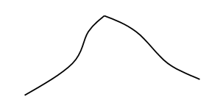


Activity: Graph Description
 Practice
Use both noun phrases (NP) and verb phrases (VP) to describe the following trends for the exchange rate in 2019.
(NP) There was a fluctuation in the exchange rate in 2019.
(VP) The exchange rate in 2019 fluctuated.
(NP) There was a peak in the exchange rate in August 2019. OR
The exchange rate in August 2019 reached a peak.
(VP) The exchange rate in August 2019 peaked.
(NP) There was a gradual decline in the exchange rate in 2019.
(VP) The exchange rate in 2019 gradually declined.

Slide 45
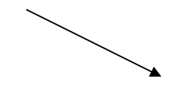


(NP) There was a levelling out in the exchange rate in the last 4 months in 2019.
(VP) The exchange rate in the last 4 months in 2019 levelled out.
(NP) There was a substantial drop in the exchange between time A and time B in 2019.
(VP) The exchange rate between time A and time B in 2019 dropped substantially.
(NP) There was a significant rise in the exchange rate between time A and time B in 2019.
(VP) The exchange rate between time A and time B in 2019 rose significantly.

Slide 46
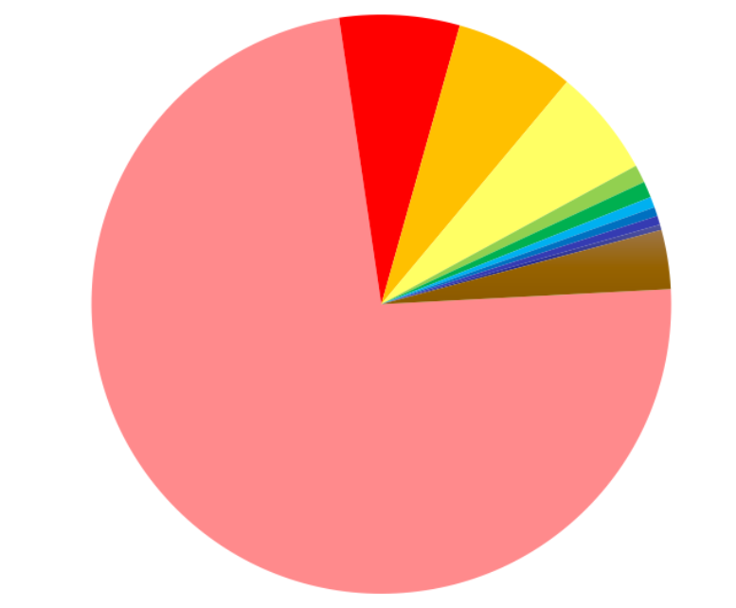
Describing Patterns
Majority
Almost all
90%
75%
33%
25%
20%
3%
3 quarters
A large proportion
One third
A quarter
One fifth
Minority

Slide 47
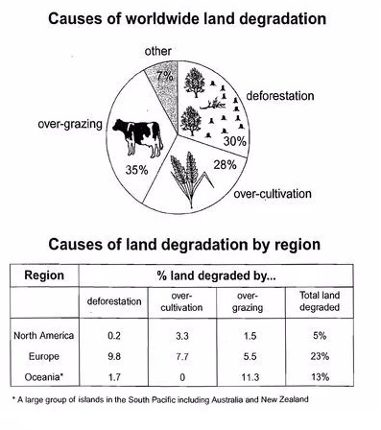
Understanding Graphs: Pie Chart + Table
Think about:
1-2 key patterns from the Pie Chart;
1 key data in the Table;
Which tense to use.

Slide 48
The pie graph displays the principal causes why farming land deteriorates while the table illustrates how three regions of the planet are affected by these factors. (introductory line)
Overall, there are three primary causes of farmland degradation, and over-grazing is the major one. The table shows that Europe has a far higher percentage of unproductive land compared to the other two regions. (overview)
The pie chart represents four causes, with over-grazing representing the biggest proportion at just over a third. Widespread clearing of trees and the over-use of crops constitute nearly one third and just over a quarter respectively. (body 1)
On the other hand, The table shows that nearly one quarter of Europe’s entire surface has fallen victim to degeneration. Only a small proportion of North America’s total land becomes less productive at 5% and Oceania is marginally higher with a value of 13%. (body 2)
In summary…
the three major causes of land degradation affect various areas, particularly in Europe. (13 words)

Slide 49
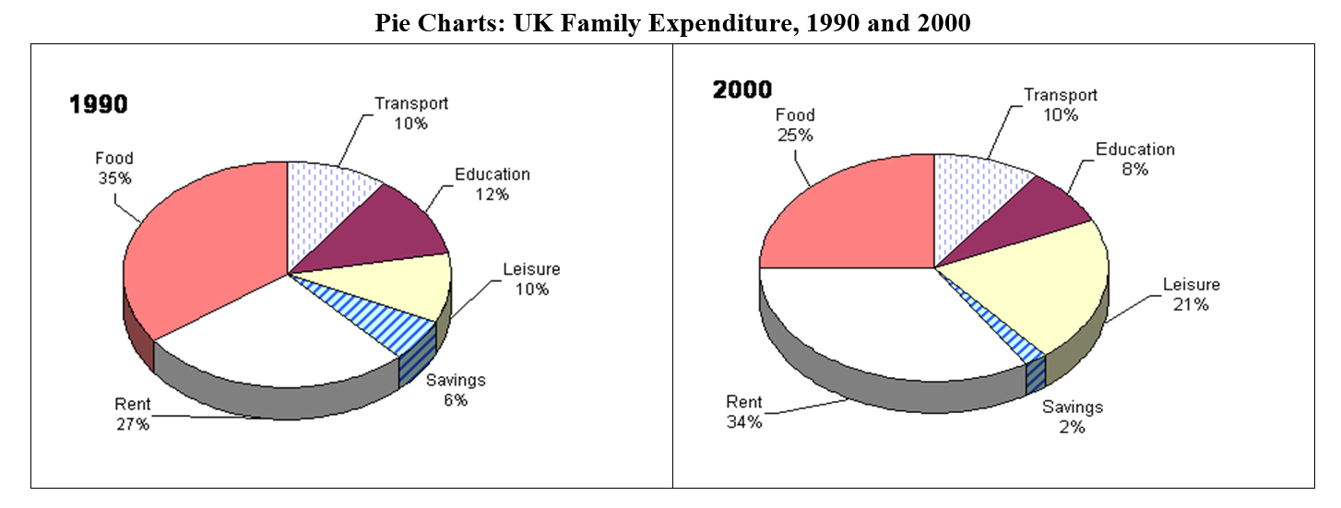
Language: Verb Use in Graph Description
 Insert appropriate verbs in the following description of UK Family Expenditure, 1990 and 2000.

Slide 50
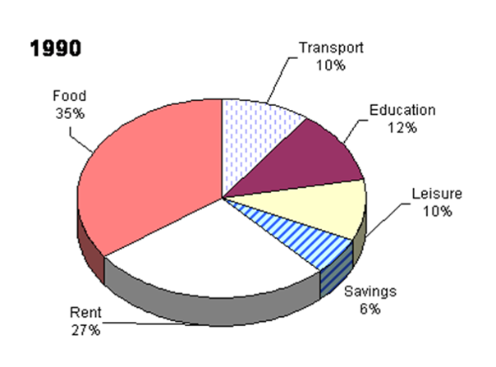
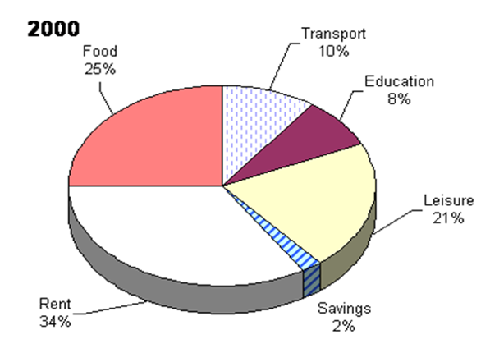
The two pie charts ____________ changes in the amount of money spent by families in the UK between 1990 and 2000.
Rent ____________ sharply in the ten-year period. In 1990, it ____________ for 27% of family expenditure while in 2000, this figure ____________ to 34%. Spending on leisure also ____________ significantly from 10% in 1990 to 21% in 2000, more than ____________over the ten years.
However, the budget for other areas _____________ considerably. Food ____________ up 35% of household spending in 1990 but ____________ to only 25% in 2000, a fall of almost one-third. Education expenses also ____________. In 1990, schooling ____________ 12% of spending but only 8% in 2000. The amount of money saved also ____________ dramatically, from 6% in 1990 to just 2% ten years later.
Overall, variation on different expenditures was observed over the ten-year period in question.
compare
increased
accounted
rose
grew
a double
decreased
took
dropped
declined
contributed to
reduced

Slide 51
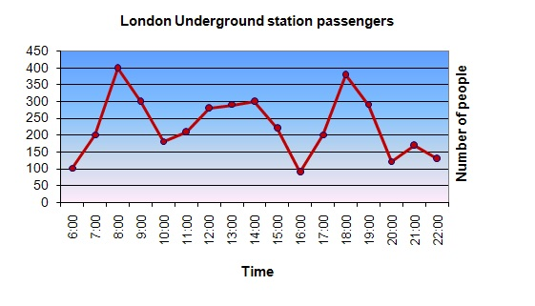
Graph Analysis: Line Graph
The graph shows Underground Station passenger numbers in London.
Summarise the information by selecting and reporting the main features, and make comparisons where relevant.
You should write at least 150 words. You should spend about 20 minutes on this task.

Slide 52
The line graph demonstrates data on the number of underground station commuters of London from 6 am till 10 pm in a day. As observed from the graph, there are fluctuations during the period, with two peaks at 8 am and 6 pm.
Initially, the number stands at 100 at 6 am, then it surges to 400 two hours later, which showcases a peak. After that, this figure drops by 200 to 200 at 10 am, a 50% decrease. From this point onwards, there is a gradual upward trend from 200 to 300 between 10 am and 2 pm.
However, a further plummet is observed at 4 pm from 300 to only 100, indicating the lowest point in the graph. From 4 pm to 6 pm, the figure, nevertheless, skyrockets to approximately 400 again, showing another peak. After 6:00 pm, the passenger number decreases with some fluctuations until 10:00 pm.
In summary, the highest number of passengers of London underground stations can be found during the office-going and office-leaving times in a day.
(173 words)

Slide 53
Please take some time to have self-revision for crucial points in the notes.
Take some time to practise as well. (time + hand-write)
Writing Consultation: Week 4-5 second hour of the lesson

